Slide 1
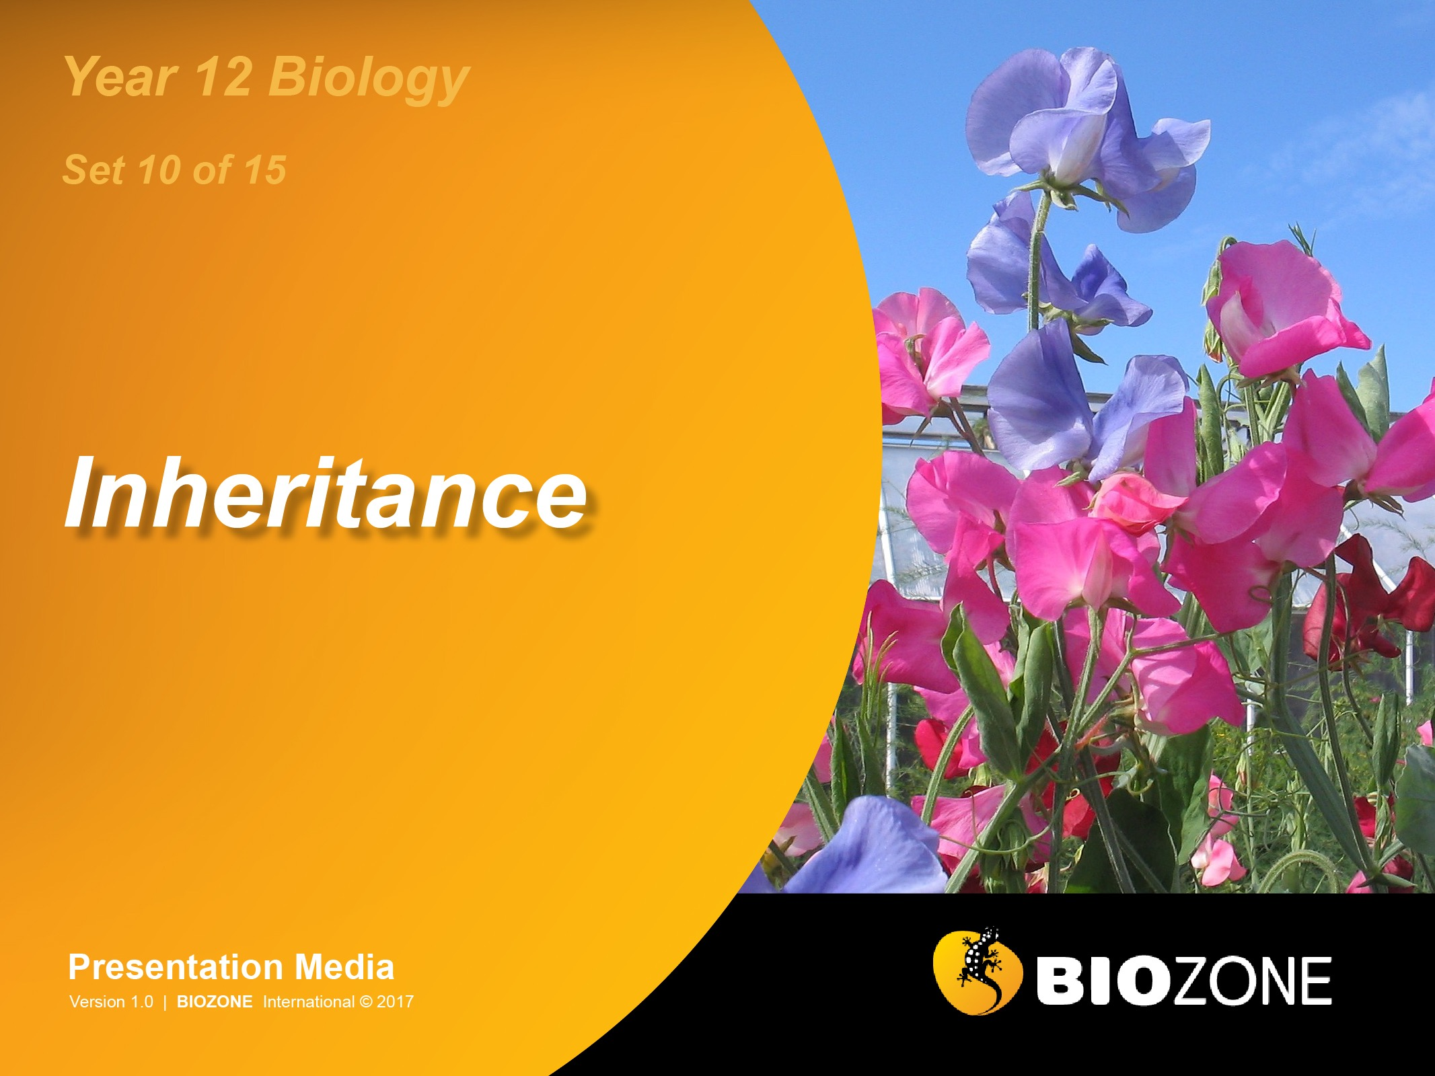

Slide 2
Variation
Sources of variation
Phenotypes
Mutations
Non-disjunction
Aneuploidy
Mendelian Genetics
Gregor Mendel
Mendel’s pea experiments
Mendel’s laws
Alleles
Monohybrid crosses
Dihybrid crosses
Non-Mendelian genetics
Linked genes
Mitochondrial DNA
DNA methylation
Sex chromosomes
Sex determination
Sex linkage
Polygeny
Pedigree analysis

Slide 3
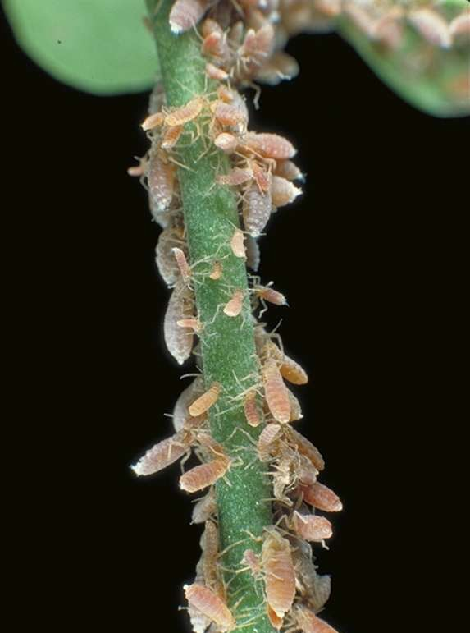
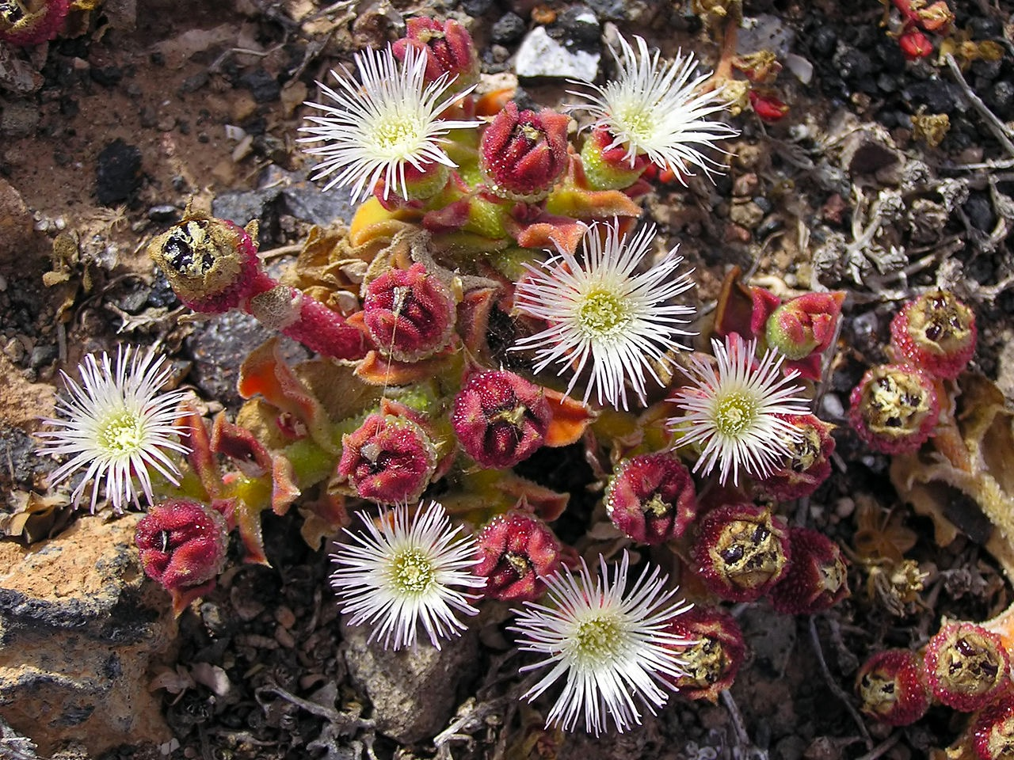
Sources of Variation
Variation refers to the diversity of genetic and phenotypic traits within and between populations.
Variation is a feature of sexually reproducing populations and it is the essential raw material for selection. Variation gives species greater opportunity to adapt to and survive in a dynamic environment.
Populations of highly variable species will include individuals with different fitness in the prevailing environment. It is this variability that offers the chance of reproductive advantage if environments change.
Species with low variability (such as populations of clones) can be highly successful in stable conditions, but will reproduce sexually when environments become unfavourable for just this reason.
Phenotype is influenced by both genotype and the environment. Even organisms of fixed genotype may differ in how much their phenotype can change in response to environment (a phenomenon known as phenotypic plasticity).
These aphids are clones
Mesembryanthemum (ice plants) show phenotypic plasticity nn their use of water

Slide 4
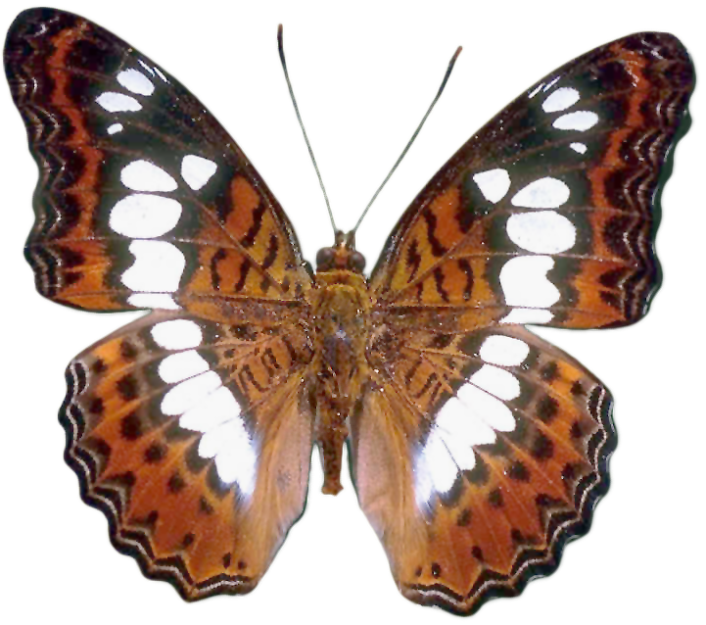
Sources of Variation
Mutations
gene mutations, chromosome mutations
Mutations are the source of all new alleles. Existing genes are modified by base substitutions and deletions, causing the formation of new alleles. Silent mutations may escape selection pressure until conditions change.
Sexual reproduction
independent assortment, crossing over and recombination, mate selection
Sexual reproduction rearranges and reshuffles the genetic material into new combinations.
Phenotype
An individual’s phenotype is the result of the interaction of genetic and environmental factors during its lifetime (including during development). The genetic instructions for creating the individual may be modified by the internal and external environment both during and after development. Phenotypic plasticity in response to environment can be adaptive if it increases fitness.
Genotype
Determines the genetic potential of an individual
Environmental factors
The external and internal environments can influence the expression of the genotype. The external environment may include physical factors such as temperature or light intensity, or biotic factors such as competition. The internal environment, e.g presence or absence of hormones or growth factors during development, may also affect genotypic expression.

Slide 5
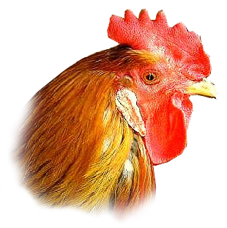
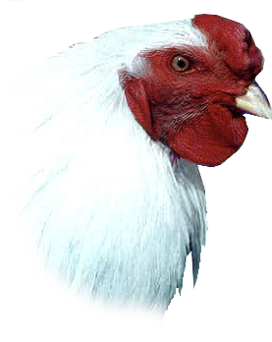
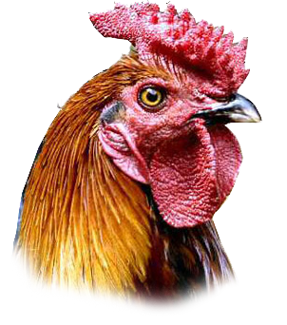
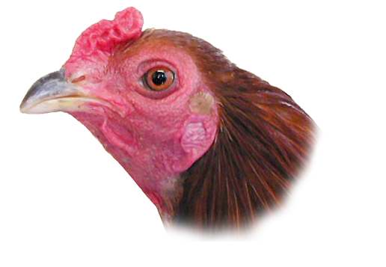

Qualitative and Quantitative
Comb shape in poultry is a qualitative trait and birds have one of four phenotypes depending on which combination of four alleles they inherit.
Quantitative traits are characterised by continuous variation, with individuals falling somewhere on a normal distribution curve of the phenotypic range.
Typical examples include skin colour and height in humans grain yield in corn growth in pigs and milk production in cattle.
Quantitative traits are determined by genes at many loci (polygenic) but most are also influenced by environmental factors.
Chicken combs are a qualitative trait
iStock
Skin colour is a quantitative trait

Slide 6


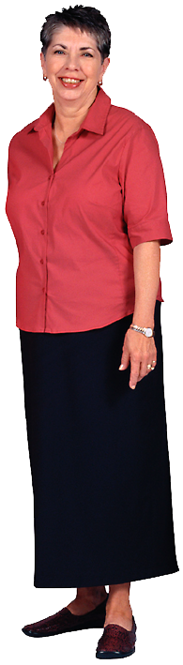

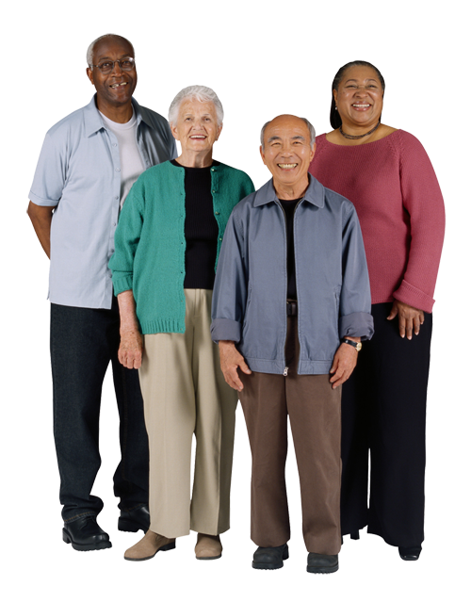
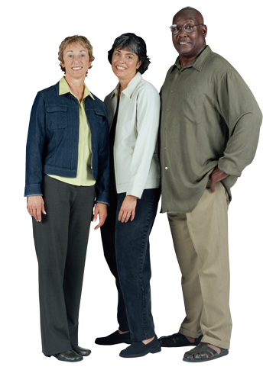

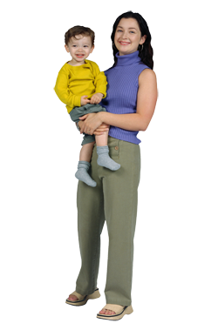

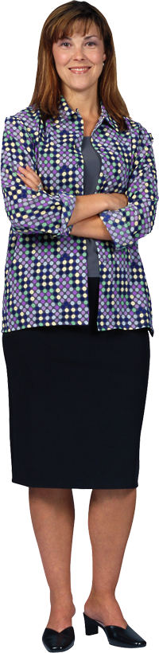
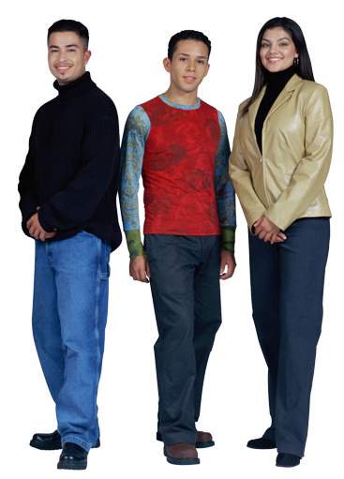
Phenotype
The phenotype is a combination of:
The genes that are expressed.
All the environmental influences from the moment that the egg is fertilised.
Environment contributes most obviously to the phenotypic range of characteristics for which there is no rigidly defined phenotype associated with a particular genotype, e.g. skin colour.

Slide 7
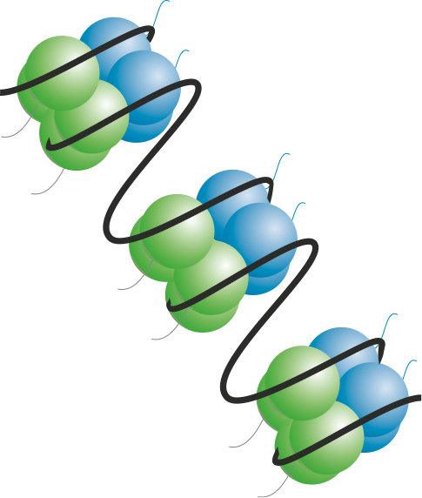
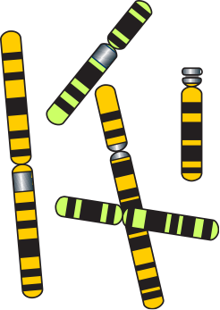
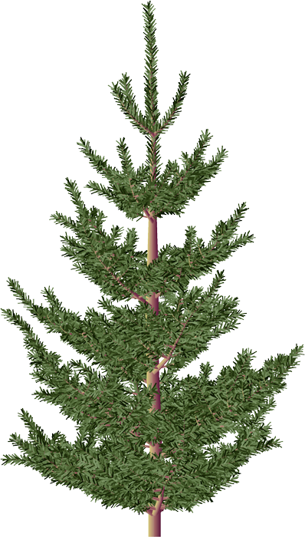
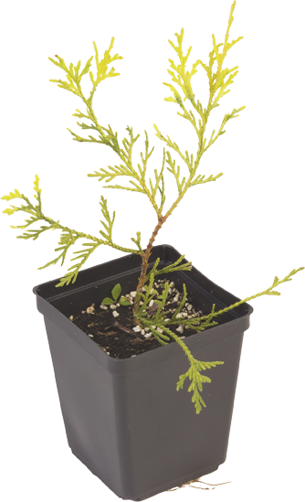
Influences on Phenotype
Epigenetics
Source of
genetic variation
Genotype
Histone modification
DNA methylation
Dominant alleles
Recessive alleles
Mutations
Crossing over
Independent assortment
Gene interactions
Influenced by the environment
Combine in their effects
Provides
inherited variation
Source of
environmentally induced variation
Wind Water availability
Acidity
Temperature
Soil type
Light
Predation
Provides
non-inherited variation
Phenotype
Environment
The resulting phenotype is the product of the effects of the environment on genetic potential

Slide 8


Types of Mutation 1
Gene mutations
Genetic change affecting the base sequence of a single gene.
Gene mutations may result in the formation of a new allele.
Mutation: Substitute T instead of C
Original
DNA
Mutant DNA

Slide 9


Types of Mutation 2
Chromosome mutations (also called block mutations)
Changes in the structure of a chromosome involving large pieces being rearranged.
Whole groups of genes are affected.
Chromosome segment is lost
Break
Break
Genes

Slide 10


Types of Mutation 3
Changes in chromosome number
Aneuploidy: The loss or gain of whole chromosomes.
Polyploidy: The loss or gain of complete sets of chromosomes.
21
The example above illustrates trisomy 21, a condition that is responsible for Down syndrome

Slide 11

Point Mutations 1
Gene mutations change the sequence of bases in DNA for a single gene. They may produce a new allele of a gene.
Gene mutations involving a single nucleotide are usually called point mutations.
The new DNA sequence may result in a new sequence of the amino acids constituting a protein.
Because of the degeneracy in the genetic code, not all changes in a DNA sequence will result in a new sequence of amino acids.
Even with a change in amino acid sequence, protein function may be unaffected (the mutation is silent).
Mutant DNA

Slide 12


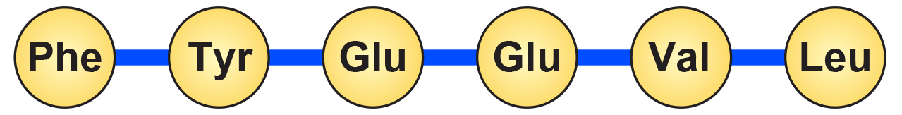
Point Mutations 2
As a reference for the following screens, the diagram below illustrates the transcription and translation of DNA without a point mutation.
Original unaltered code
Original DNA
Transcription
mRNA
Translation
Amino acids
Amino acid sequence forms a normal polypeptide chain

Slide 13

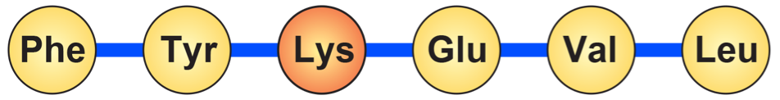
Missense Substitution
A single base is substituted with another, resulting in a codon that codes for a different amino acid.
Mutation: Substitute T instead of C
Original DNA
Mutant DNA
mRNA
Amino acids
Polypeptide chain with wrong amino acid

Slide 14


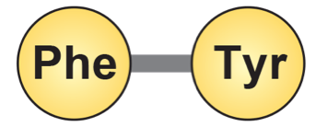
Nonsense Substitution
A single base is substituted by another.
This results in a new triplet that does not code for an amino acid.
The resulting triplet may be an instruction to terminate the synthesis of the polypeptide chain.
Mutation: Substitute A instead of C
Original DNA
Mutant DNA
mRNA
Amino acids
Mutated DNA creates a STOP codon which prematurely ends synthesis of the polypeptide chain

Slide 15


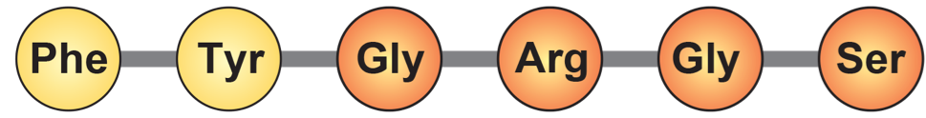
Reading Frame Shift by Insertion
A single base is inserted, upsetting the reading sequence for all those after it.
A reading frame shift results in new amino acids in the polypeptide chain from the point of insertion onwards.
The resulting protein will be grossly different from the one originally encoded (it is most likely to be non-functional).
Mutation: Insertion of C
Original DNA
Mutant DNA
mRNA
Large scale frame shift results in a new amino acid sequence. The resulting protein is unlikely to have any biological activity.
Amino acids

Slide 16



Partial Reading Frame Shift
A single base is inserted and another is deleted at a different location. This causes a localised frame shift.
The amino acid sequence between these points changes.
Depending on how many amino acids are affected, the resulting protein may have some biological activity.
Mutation: Insertion of C
Mutation: Deletion of C
Original DNA
Mutant DNA
mRNA
Altered chain which may or may not produce a protein with biological activity
Amino acids

Slide 17

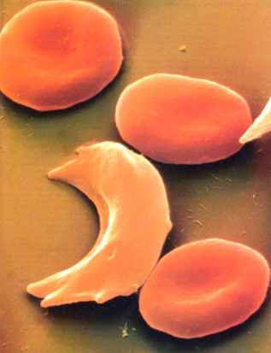
Sickle Cell Anemia
Synonym: Sickle cell disease
Incidence: Most common in people of African ancestry.
West Africans: 1% (10-45% are carriers)
West Indians: 0.5%
Gene type: Autosomal mutation (HBB) on chromosome 11 which results in the substitution of a single nucleotide in the HBB gene coding for the beta chain of haemoglobin.
The allele is codominant.
HBB
Gene location: Chromosome 11
p
q
Normal red blood cells
Sickle-cell
Photo Defiers.com

Slide 18
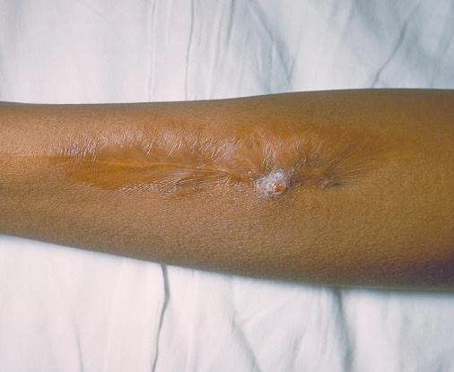
Sickle Cell Disease
Treatment and outlook:
Patients are given folic acid.
Acute episodes may require:
oxygen therapy
intravenous infusions of fluid
antibiotics to treat infection
Experimental therapies include bone marrow transplants and gene therapy.
(Photo CDC)
Sickle cell lesion

Slide 19
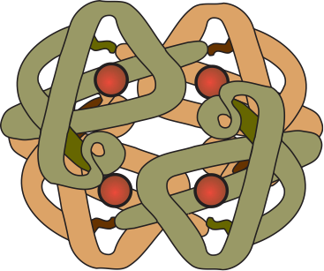
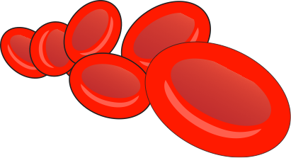

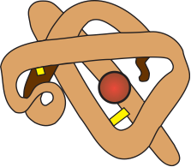

Sickle Cell Mutation
The mutation responsible for causing sickle cell disease is a point substitution.
Hemoglobin molecules
are made up of 2 α-chains and 2 β-chains linked together
Normal red blood cells
containing normal haemoglobin (soluble)
Sickle cells
containing mutant haemoglobin (less soluble)
Beta (β) chain
Alpha (α) chain
Red blood cells normally have a biconcave shape, which enables them to squeeze through capillaries.
When deprived of oxygen, haemoglobin precipitates to form fibres, which deform the red blood cells into a sickle shape.
β-Chain
hemoglobin
First base
Normal base: T
Substituted base: A
The sickle cell mutation involves the substitution of one base for another in the HBB gene, causing a single amino acid to be altered.
DNA
Codes for the 1st amino acid

Slide 20

Cystic Fibrosis
Cystic fibrosis (CF) is an example of a harmful mutation in humans.
Synonyms: Mucoviscidosis, CF
Incidence: Varies with populations:
People of Asian ethnicity: 1 in 10,000
People of European ethnicity: 1 in 20-28 are carriers
Mutation type: Autosomal recessive. Over 500 different recessive mutations of the CFTR gene have been identified:
deletions, missense, nonsense, terminator codon
p
q
CFTR
Gene location
Chromosome 7

Slide 21


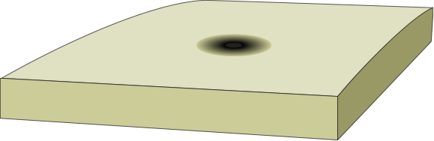
Cystic Fibrosis Mutation
The mutation causing 70% of cystic fibrosis cases is a gene mutation (delta F508) involving a net triplet deletion.
Base 1630
CFTR protein
Part of the DNA sequence in the CFTR gene
This triplet codes for the 500th amino acid
These three bases are deleted from the 507/508th triplets in the DF508 mutation
Cl-
Cl-
Cl-
Water
Cl-
Outside the cell
Outside the cell
Plasma membrane
Cell cytoplasm
Cell cytoplasm
Cl-
Cl-
Cl-
Cl-
Cl-
Cl-
Cl-
Normal CFTR protein
regulates chloride transport across the membrane
Mutant CFTR protein
cannot regulate chloride transport. Chloride ions remain in the cell and water enters the cell

Slide 22
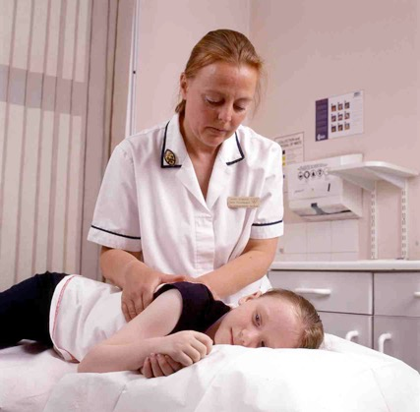
Cystic Fibrosis
Symptoms:
Infertility occurs in males and females.
Disruption of the following glands:
the pancreas
intestinal glands
biliary tree (biliary cirrhosis)
bronchial glands (chronic lung infections)
sweat glands (high salt content of which becomes depleted in hot environments)
Conventional treatment
Chest physiotherapy.
A modified diet.
Supplementary pancreatic enzymes.
The use of antibiotics to control lung infections.
Future treatments?
Gene therapy inserting normal CFTR gene using adenoviral vectors and liposomes.
(Photo: UK Cystic Fibrosis Gene Therapy Consortium)
A child with cystic fibrosis undergoing chest massage in order to expel mucus

Slide 23
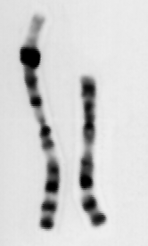
Causes of Block Mutations
Some block (chromosome) mutations occur as a result of errors in crossing over during meiosis.
Mutagens also cause block mutations.
Block mutations cause genetic imbalances which usually disrupt development. They can be described as:
Inversion: Pieces of chromosome are flipped so the genes appear in reverse order.
Translocation: Pieces of chromosome are moved from one chromosome into another.
Duplication: Pieces of chromosome are repeated so there are duplicate segments.
Deletion: Pieces of chromosome are lost.
Photo Cytogenetics Dept. Waikato Hospital

Slide 24

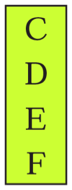
Block Mutations: Deletion
Break occurs at two points on the chromosome and the middle piece falls out.
The two ends rejoin to form a chromosome deficient in some genes.
Alternatively, the end of a chromosome may break off and be lost.
Chromosome
rejoins
Break
Break
Segment is lost
Genes
Step 1
Step 2
Step 3

Slide 25




Deletion Example
Human chromosome 1 shows two forms of deletion.
These may involve deletion of either a chromosome tip (left) or a middle segment with the tip rejoined (right).
Deletions involving small amounts of chromosomal material underlie several disorders, including:
Cri-du-chat syndrome
Prader-Willi syndrome
Angelman’s syndrome
Deletions of large amounts of chromosomal material are usually lethal.
Tip deletion
Mid-segment deletion
Before
After
Before
After
Tip
rejoins
1
1
Lost
Lost
1
1

Slide 26



Block Mutations: Translocation
Translocation involves the movement of a group of genes between different chromosomes.
A piece of one chromosome breaks off and joins on to another chromosome.
The result is a chromosome deficient in genes and one with too many genes.
Segment removed
Segments join
Break
Genes
Step 1
Step 2
Step 3

Slide 27




Translocation Example
Translocation can occur between human chromosomes 9 and 22.
The tips of the two chromosomes are exchanged.
This is the translocation observed in chronic myeloid leukaemia.
Before translocation
After translocation
22
22
9
The tips of the chromosomes swap
9

Slide 28
Block Mutations: Inversion
The middle piece of the chromosome falls out, rotates through 180°, and then rejoins.
There is no loss of genetic material.
Break
Segment rejoins
Break
Segment rotates 180°
Genes
Step 1
Step 2
Step 3

Slide 29
Inversion Example
A segment of human chromosome 2 is inverted (caused by looping of the chromosome)
All inversions cause abnormalities during meiosis and affect the viability of the gametes produced.
However, if a combination of genes within an inversion is desirable, they can act as a supergene and can confer a selective advantage.
Normal
Inversion
Flip
2
2

Slide 30





Block Mutations: Duplication
A segment is lost from one chromosome and is added to its homologue.
The chromosome on the left was the 'donor' of the duplicated piece of chromosome.
The chromosome with the duplication will become incorporated into a gamete, which may later contribute to an embryo.
Segment removed
Joins on to
homologous
chromosome
Break
Genes
Step 1
Step 2
Step 3

Slide 31


Duplication Example
A segment of human chromosome 9 is duplicated.
A segment is taken from its homologue and inserted to produce double copies of some genes.
Some genes may be disrupted.
Gene duplications can have evolutionary significance.
Example: The alpha and beta chains of haemoglobin arose following a duplication event 500 million years ago.
Normal
Duplication
Duplicate segment
A segment is transferred from one chromosome into its homologue
Identical segment
9
9

Slide 32

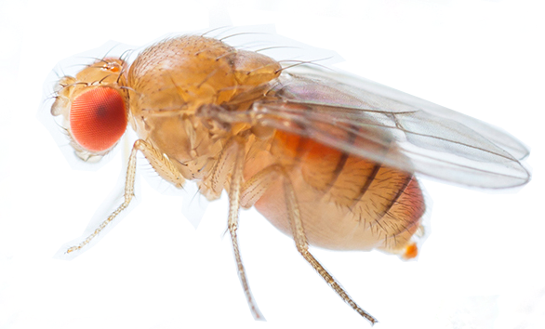
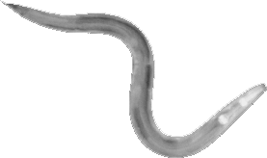
Gene Duplication
Studies have shown that gene duplication has occurred in virtually every species and often more than once.
It is well known that many important crop plants (e.g. wheat) have duplicated not just one gene, but their entire genome.
The duplication of a gene frees one of those genes to develop a new function, while the original continues as it was.
In the case of genes that produce proteins with a tendency or ability to perform two functions, there may be adaptive conflict, in which its ability to perform one function compromises its ability to perform another.
Gene duplication solves this problem by allowing natural selection to act on the genes so that they follow different evolutionary paths.
Homo sapiens: 38% genes duplicated
Drosophila melanogaster
(fruit fly): 41% genes duplicated
Caenorhabditis elegans
(nematode): 49% genes duplicated

Slide 33
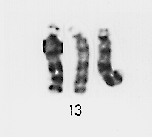
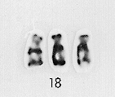
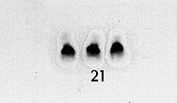
Non-disjunction in Meiosis
The meiotic spindle normally distributes chromosomes to daughter cells without error. However, mistakes can occur during meiosis in which the chromosomes, or sister chromatids, fail to separate properly at anaphase.
This mishap is called non-disjunction. It can occur during meiosis I or meiosis II.
Non-disjunction results in abnormal numbers of chromosomes passing to the gametes.
If either of these aberrant gametes unites with a normal one at fertilisation, the offspring will have an abnormal chromosome number.
This is known as an aneuploidy, e.g. trisomy.
Photos: Cytogenetics Dept. Waikato Hospital
Trisomy 13
Trisomy 18
Trisomy 21

Slide 34
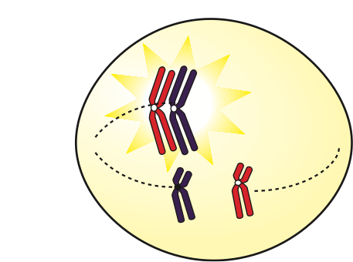
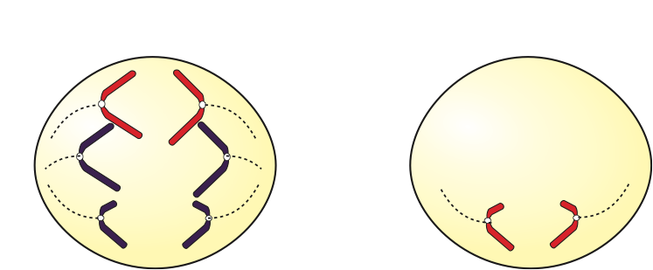

Non-Disjunction: Meiosis I
A non-disjunction in meiosis I occurs when homologous chromosomes fail to separate properly during anaphase I.
One gamete receives two of the same sort of chromosome and the other gamete receives no copy.
Non-disjunction
Meiosis I
Meiosis II
Gametes
n+1
n+1
n–1
n–1

Slide 35
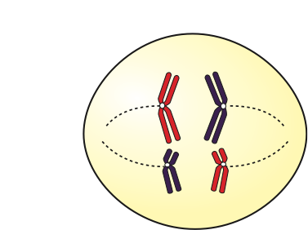
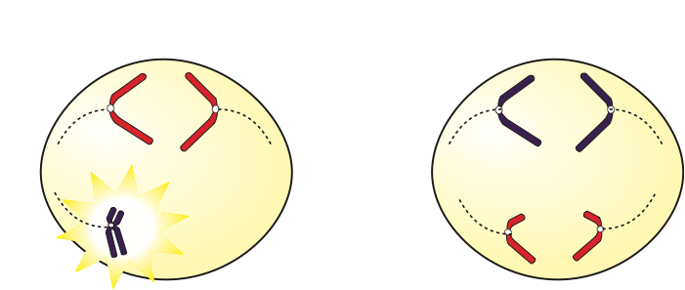

Non-Disjunction: Meiosis II
A non-disjunction in meiosis II occurs when sister chromatids fail to separate properly during anaphase II.
One gamete receives two of the same sort of chromatid and the other gamete receives no copy.
Some gametes are unaffected.
Meiosis I
Meiosis II
Non-disjunction
Gametes
n+1
n–1
n
n

Slide 36



Faulty Sperm Production
Male
Female
Aneuploidy in human sex chromosomes may result from faulty sperm production.
This results from failure of the X and Y chromosomes to separate during meiosis (non-disjunction).
Primary spermatocyte
Mistake during meiosis
XY
XX
XY
X
X
Faulty gametes
XY
XY
X
X
X
X
Adobestock
Offspring
XXY
XO
XXY
XO
Klinefelter
syndrome
Turner
syndrome
Klinefelter
syndrome
Turner
syndrome

Slide 37
Faulty Egg Production
Male
Female
Aneuploidy in human sex chromosomes may result from faulty egg production.
This results from failure of the two X chromosomes to separate during meiosis (non-disjunction).
XY
XX
Primary
oocyte
X
Y
XX
Mistake
during
meiosis
X
X
Y
Y
XX
XX
Faulty gametes
Adobestock
XXX
XXY
XO
YO
Offspring
Metafemale
Klinefelter
syndrome
Turner
syndrome
Not viable

Slide 38
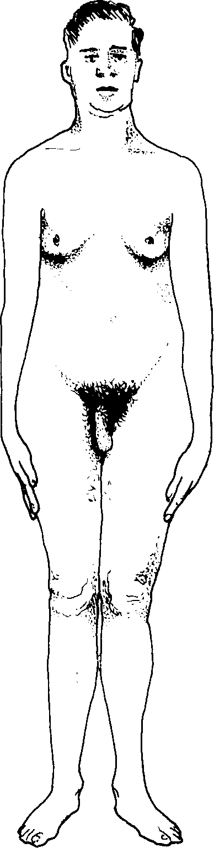
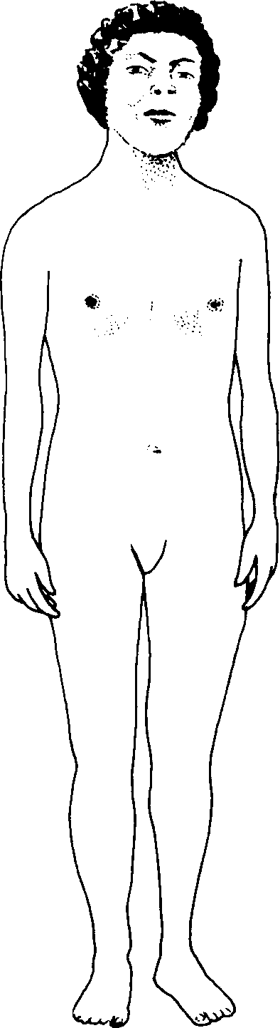
Aneuploidy in Sex Chromosomes
Unusual sex chromosome configurations can arise from mistakes made during gamete formation (failure of sex chromosomes to separate properly during meiosis).
XO, monosomic | Female | Turner syndrome
XX, disomic | Female | Normal female
XXX, trisomic | Female | Metafemale. Most appear normal; they have a greater tendency to criminality
XXXX, tetrasomic | Female | Rather like Down syndrome, with low fertility and intelligence
XY, disomic | Male | Normal male
XYY, trisomic | Male | Jacob syndrome. Apparently normal male, tall, aggressive.
XXY, trisomic | Male | Klinefelter syndrome. Incidence 1 in 10,000 live male births, with a maternal age effect.
XXXY, tetrasomic | Male | Extreme Klinefelter, mentally retarded.
Sex chromosomes and chromosome condition
Apparent sex
Phenotype

Slide 39
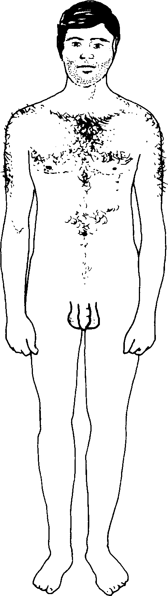
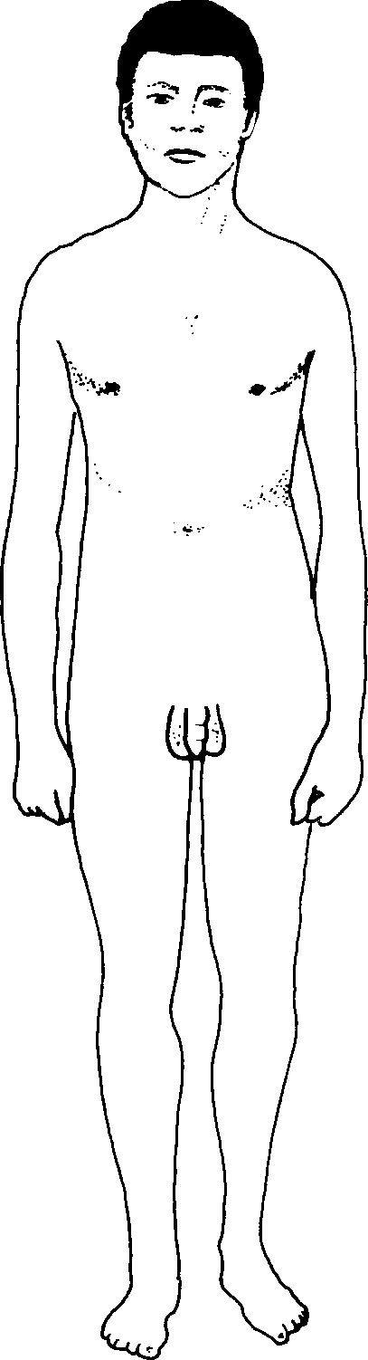
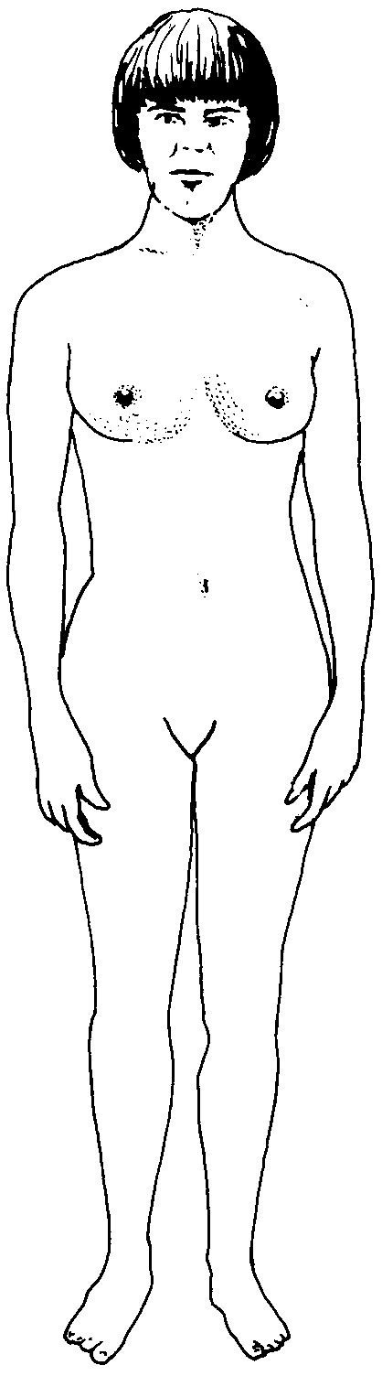
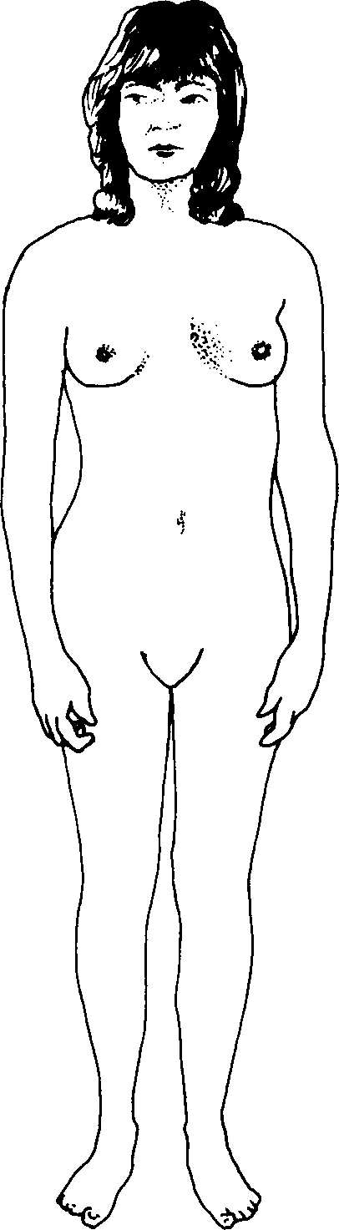
Sex Aneuploidy Phenotypes
Four phenotypes of people with abnormal numbers of sex chromosomes (together with the normal male and female phenotypes):
Normal male
Jacob syndrome
Klinefelter syndrome
Turner syndrome
Metafemale
Normal female
XXX, XXXX, XXXXX
XY
XYY, XYYY
XXY, XXXY, XXXXY
XO
XX

Slide 40
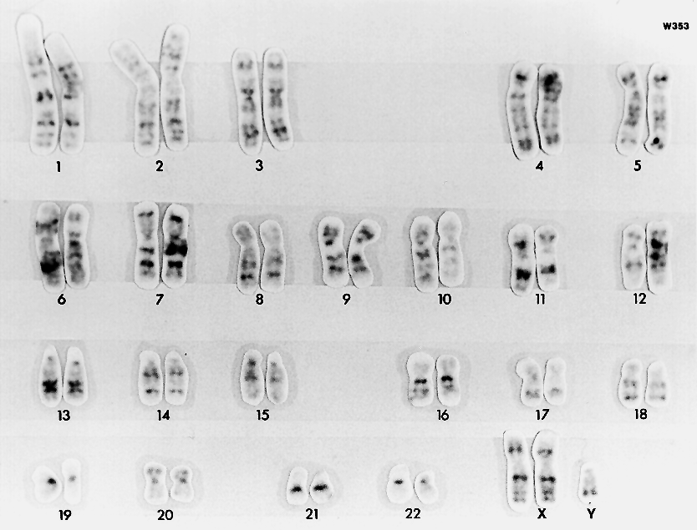
Klinefelter Syndrome
Mildly impaired IQ (intelligence)
Chromosome complement: 47, XXY
Karyotype and phenotype:
Poor beard growth
Chest hair is sparse
Frequently some breast development (low levels of testosterone)
Osteoporosis
Penis and testes underdeveloped, low levels of testosterone. Always infertile.
Female type pubic hair pattern
Photo: Cytogenetics Dept. Waikato Hospital
Limbs tend to be longer than average
Sex chromosomes: XXY

Slide 41
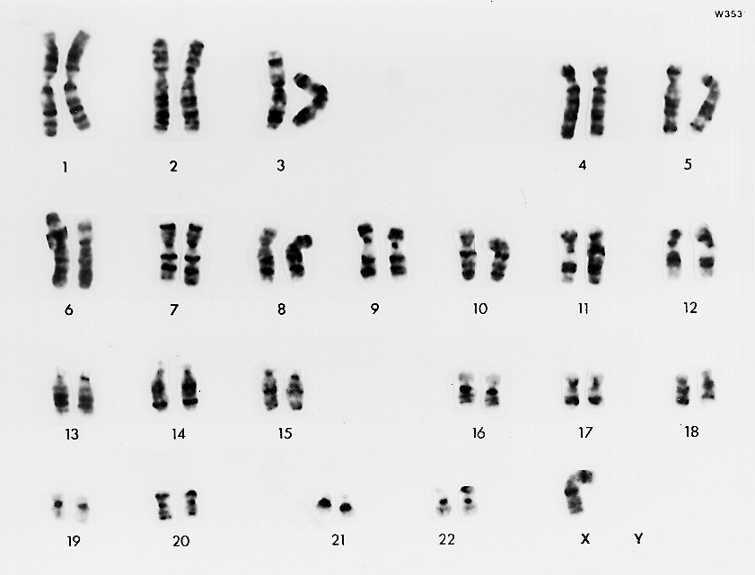
Turner Syndrome
Chromosome complement: 45, X
Karyotype and phenotype:
Mental development normal. Difficulty with spatial memory.
Characteristic residual lateral web neck
Low posterior hair line
Constriction of aorta
Poor breast development
Elbow deformity
Degenerate ovaries (almost always infertile)
Photo: Cytogenetics Dept. Waikato Hospital
Puffy fingers with deep set, hyperconvex fingernails
Reduced stature (body is typically short)
Brown spots (nevi)
Sex chromosomes: XO

Slide 42
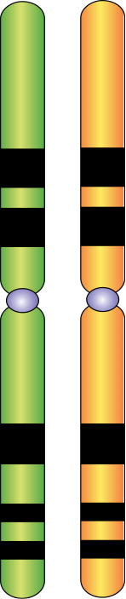
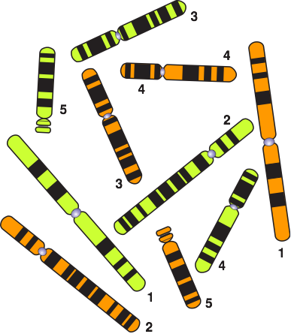
Homologous Chromosomes
This diagram illustrates the complete chromosome complement for a hypothetical organism.
It has a total of ten chromosomes, comprising five nearly identical pairs (each pair is numbered).
Paternal chromosome that originated from the sperm of this individual's father.
Maternal chromosome that originated from the egg of this individual's mother.

Slide 43


Alleles
Genes occupying the same position (locus) on homologous chromosomes are called alleles.
Genes code for phenotypic characteristics. e.g. pod colour.
Alleles are versions of the same gene that code for a variant of that phenotypic characteristic (called a trait), e.g. green pod.
In a diploid organism, one individual can only have a maximum of two alleles for a given gene.
However, there may be more than two alleles for a gene in a population, e.g. blood groups A, B, O.
Some traits (e.g. height) may be determined by alleles at many loci.
Gene A
Genes that occupy the same locus code for the same characteristic.
Gene B
Gene C
Maternal chromosome
Paternal chromosome
Pod colour in peas is a characteristic controlled by a single gene. The allele for green pods is dominant over the allele for yellow pods.

Slide 44
Alleles
These two different versions of gene A (Aa) create a condition known as heterozygous. Only the dominant allele (A) will be expressed.
When both chromosomes have identical copies of the dominant allele for a gene, (in this case BB) the organism is said to be homozygous dominant for that gene.
When both chromosomes have identical copies of the recessive allele for a gene, (in this case cc) the organism is said to be homozygous recessive for that gene.
Genes occupying the same locus or position on a chromosome code for the same characteristic and called alleles.
Maternal chromosome that originated from the egg of this person's mother.
Paternal chromosome that originated from the sperm of this person's father.

Slide 45

Sex Linkage
Sex linkage refers to the phenotypic expression of an allele that is dependent on the sex of the individual and is directly tied to the sex chromosomes.
Most sex linked genes are present on the X chromosome (X-linkage) and have no corresponding allele on the smaller male chromosome.
In some cases, a phenotypic trait is determined by an allele on the Y chromosome. Because the Y chromosome is small and does not contain many genes, few traits are Y linked and Y-linked diseases are rare.
X
Y
Note the size differences between the X and Y chromosomes. The Y lacks alleles for many of the genes present on the X.

Slide 46









Sex Linkage
Unaffected father
Carrier mother
Sex-linked traits show a distinct pattern of inheritance.
Fathers pass sex-linked alleles to all their daughters but not to their sons.
Mothers can pass sex-linked alleles to both sons and daughters.
In females, sex-linked recessive traits will be expressed only in the homozygous condition.
In contrast, any male receiving the recessive allele from his mother will express the trait.
X
Y
X
X
X
Y
X
X
X
X
X
Y
Unaffected son
Unaffected daughter
Carrier daughter
Affected son

Slide 47


Slide 48
Conditions of Use
NOTE: Presentation Media = presentations available on CD-ROM/DVD-ROM or as downloads
BIOZONE retains copyright to the intellectual property included in the Presentation Media files, with acknowledgement that certain photos are used under license and are credited appropriately.
You MAY:
Use the Presentation Media files for presentations in your classrooms using a data projector, interactive whiteboard or overhead projector.
Place the Presentation Media files on any staff computer within the school, including staff laptops, but not in contradiction to clause (g).
Place the Presentation Media files on:
The school’s intranet (school computer network)
VLE (Virtual Learning Environment)
A CMS (Content Management System).
Student and staff access must be restricted to those who are enrolled/working on the campus of the registered purchaser. Student and staff access to a VLE or a CMS must be controlled by a user login and password protocol, but not in contradiction to clause (f). If students have access, they need to be made aware of the Conditions of Use and are only allowed to view the content.
Edit and customise the Presentation Media files by adding, deleting, and modifying information to better suit your needs, but not in contradiction to clauses 2 (c) - (d).
Print out the Presentation Media files in PowerPoint® or Keynote® “Handouts” mode for the express purpose of allowing students to make their own notes about the presentation, but not in contradiction to clause (e).
You MAY NOT:
Place the Presentation Media files on to the Internet or on a service that may be accessed off-campus unless access to the service is protected by a user login and password protocol, and is restricted to students and staff enrolled/working on the campus of the registered purchaser.
Place the Presentation Media files on student laptop computers.
REMOVE any of the references to BIOZONE, the title slides, copyright notices, photo credits, or Conditions of Use from the Presentation Media files.
Create a NEW document using any of the graphics/images in the Presentation Media files.
Print the Presentation Media files on to paper to make your own worksheets for distribution to students.
Incorporate any part of the Presentation Media files for the production of another commercial product.
Share or give away any content off-campus. This prohibition apples to, but is not limited to, sharing via the Internet or any website, (examples: YouTube, slide sharing websites).
Conditions of Use are subject to change without notice. Visit http://www.biozone.com.au/faqconditionsofuse/

Slide 49
Photo Credits
Photographic images are used under license from the following commercial photo libraries:
Corel Corporation Professional Photos (uncoded)
ArtToday.com (coded AT)
Clipart.com (coded CA)
PhotoObjects.com (coded PO)
iStock.com (coded iStock)
Hemera Technologies Inc. (coded Hemera)
Photos.com (coded PC)
Education interactive (coded EII)
Digital Stock (coded DS)
LifeArt (coded LA)
Dollar Photo Club (coded DPC)
Adobestock
3D models were created using Poser
Additional artwork and photographs are the property of BIOZONE International Ltd. All rights reserved.
Some 2D artwork has been adapted from TechPool STUDIOS LifeArt Collections, used under licence.
Images from the Public Domain: Where these licenses have been used, authors and licenses have been acknowledged alongside their image.
Centers for Disease Control (coded CDC)
National Institutes of Health (coded NIH)
National Aeronautics and Space Administration (NASA)
U.S. Department of Agriculture (coded USDA)
Images from the public domain include limited copyright, copyright expired, uncopyrighted, or uncopyrightable material:
Licenses including: GNU Free Documentation License http://www.gnu.org/copyleft/fdl.html
Creative Commons Attribution Share Alike http://creativecommons.org/licenses/by-sa/3.0/
Wikimedia Commons
NOTE: Where images are edited or moved from or within this file, the accompanying photo credit must be retained.

Slide 50


